Slide 1
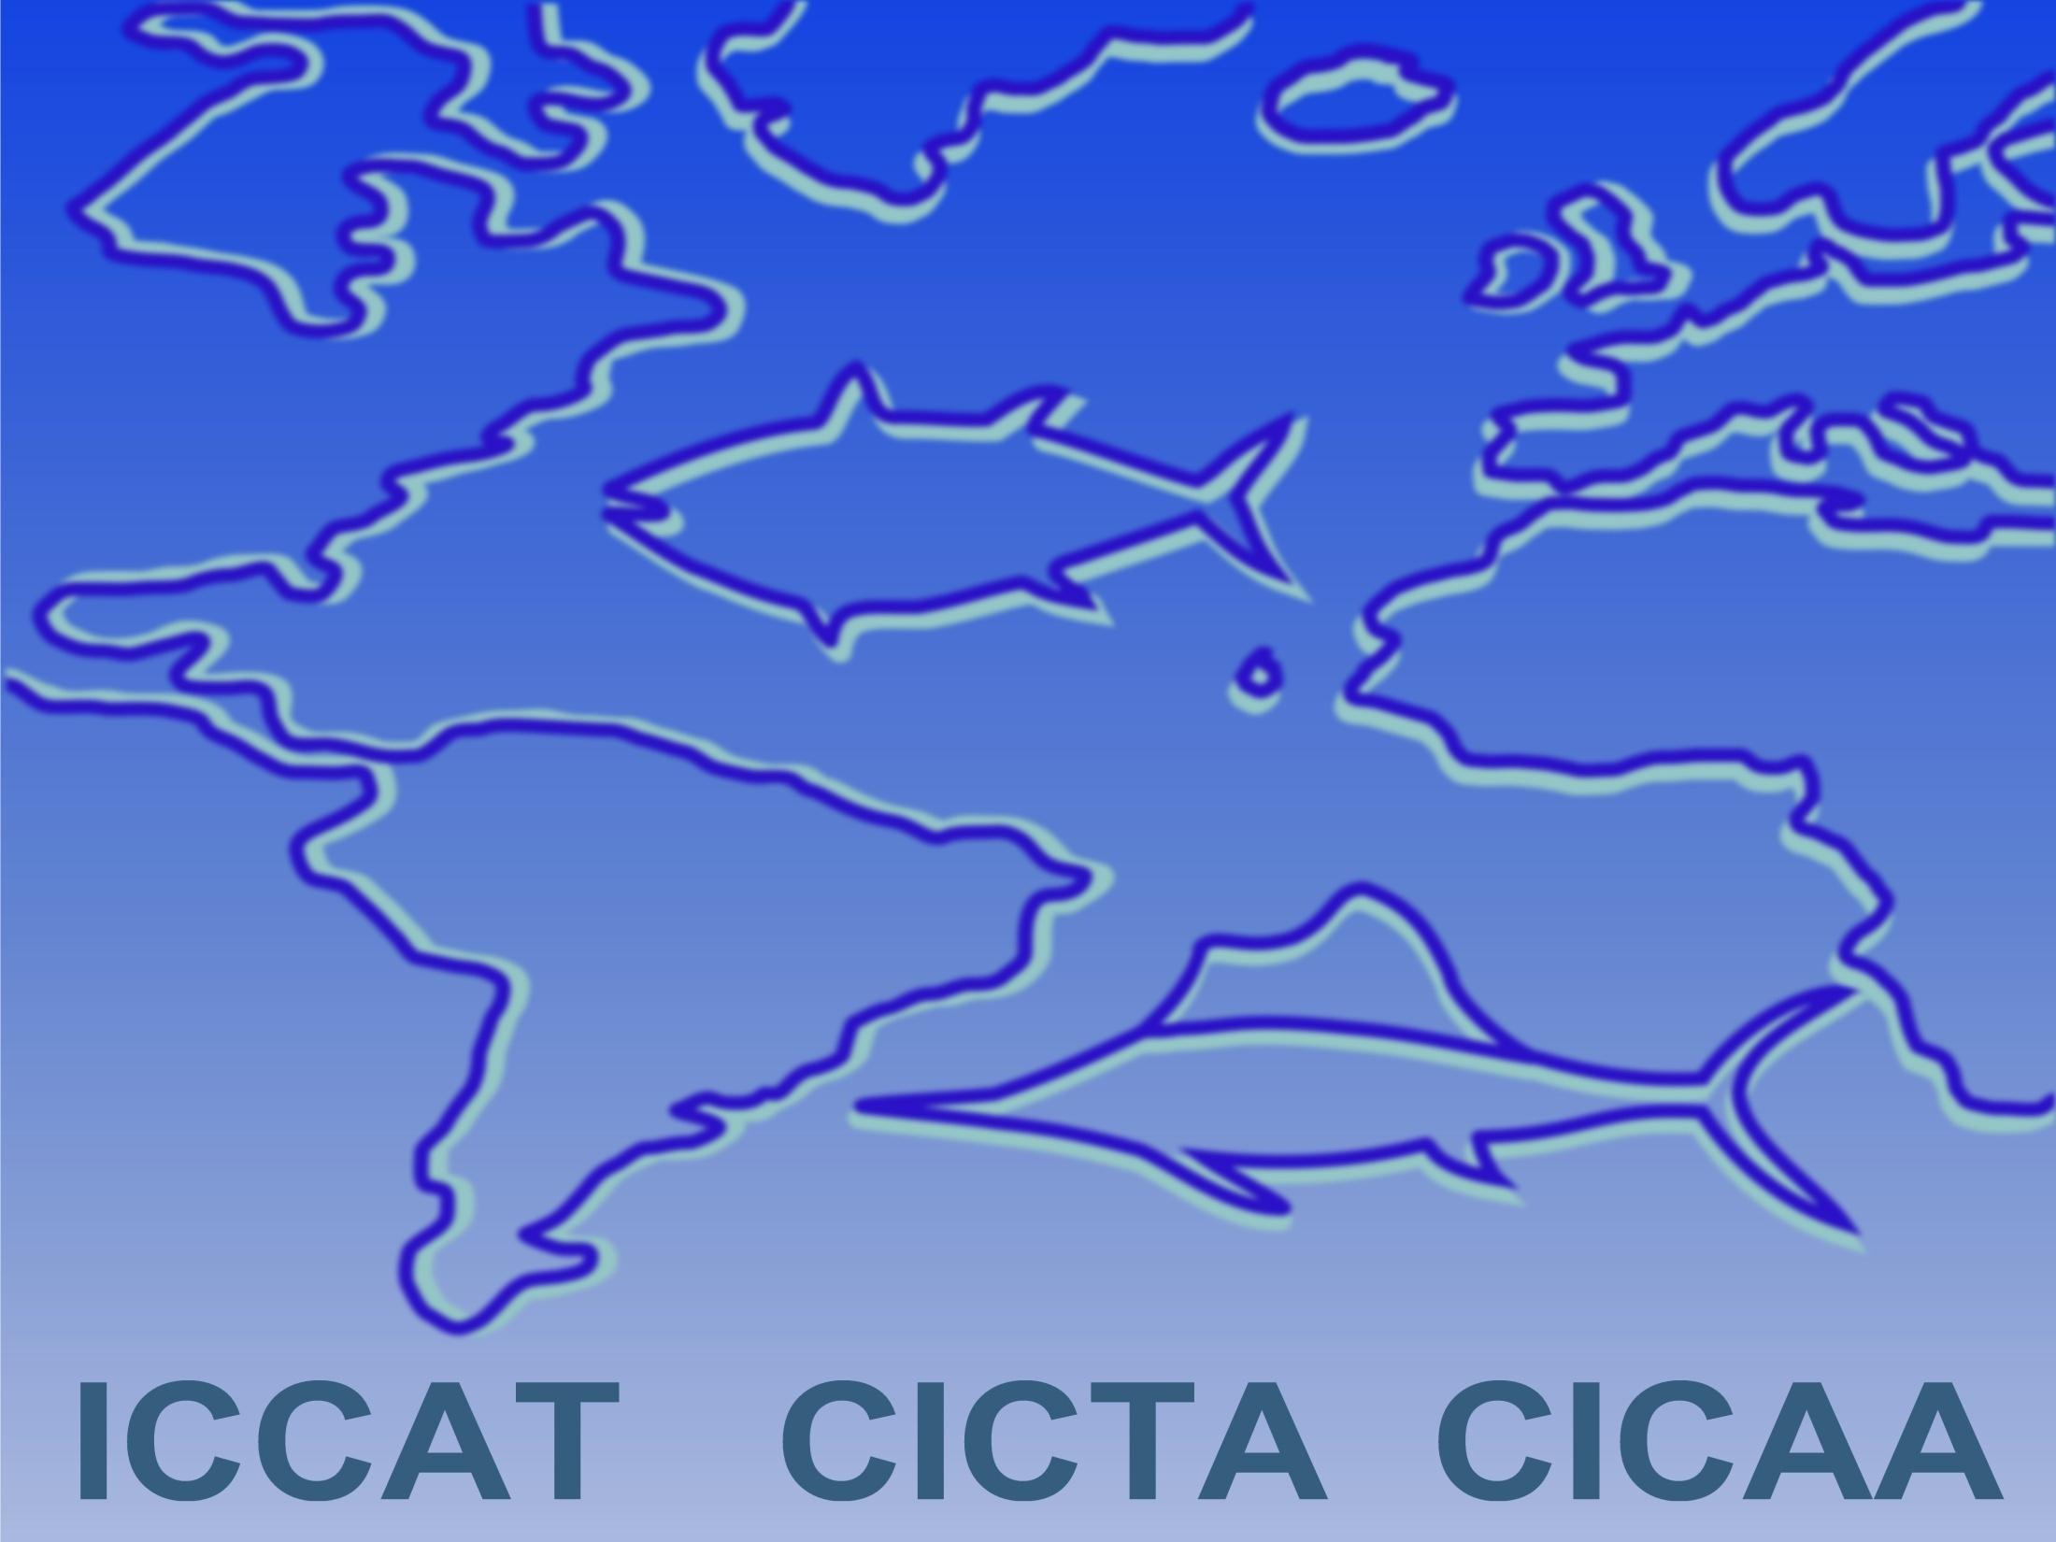
SCRS Report 2021 – PANEL 4
Swordfish
Billfishes
Sharks
Small tunas

Slide 2
Presentation Summary
Main contents of this presentation
Billfishes
  Not assessed in 2021.
  Summaries from previous assessments and fishery statistics (BUM, WHM, SAI)
Swordfish
  Not assessed in 2021.
  Status from previous Atl and Med assessments and fishery statistics.
  Summary update on N-ATL Swordfish MSE
Small tunas
  Updates on the progress of work
Sharks:
  Not assessed in 2021
  Summaries from previous assessments and statistics
Responses to the Commission
Recommendations with financial implications

Slide 3
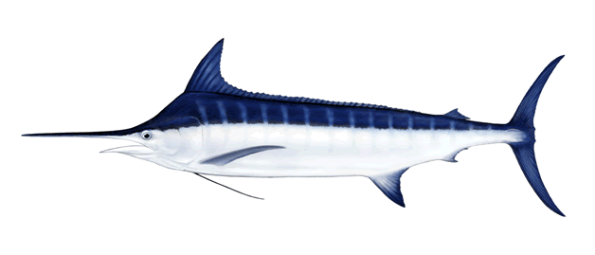
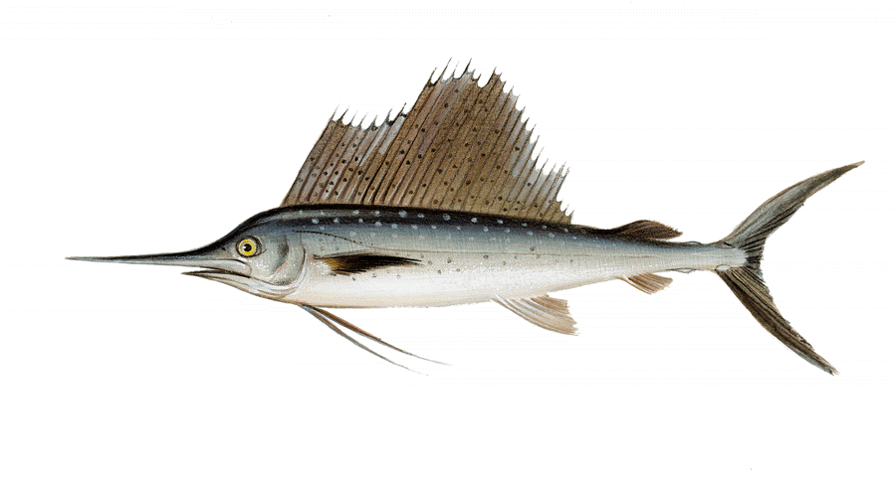
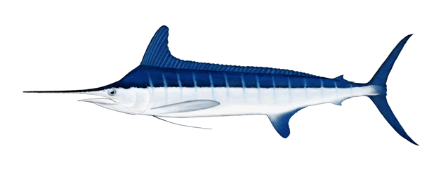
Billfishes (BUM, WHM, SAI)
Summary of billfishes – BUM, WHM, SAI

Slide 4
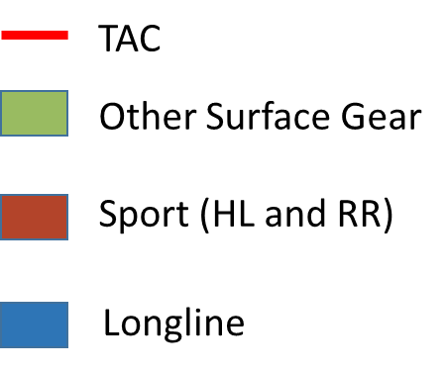
BUM Fishery Indicators
Blue marlin annual catch by gear
Catch (2020): 1,391 t
TAC (2020): 1,670 t

Slide 5
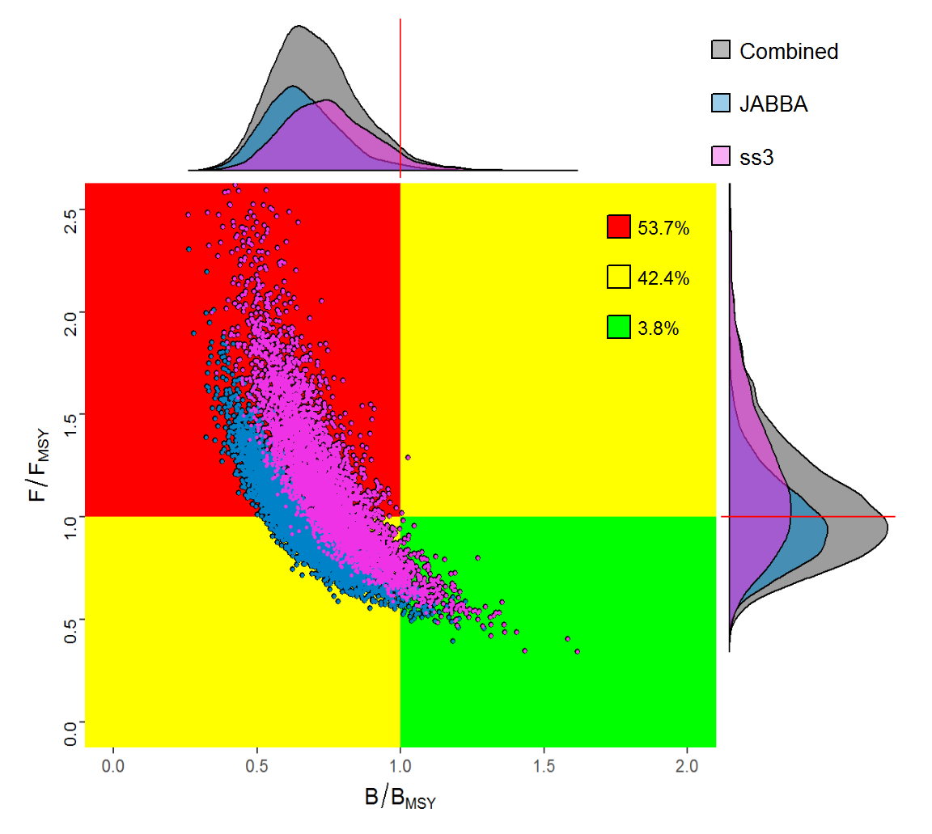
BUM State of the Stocks
Blue marlin status
Last assessment in 2018 (estimates of stock status for 2016)
Results showed that the stock was overfished and undergoing overfishing.
Stock status in 2016
Combined Kobe plot from production and integrated models
Notes:
The results of the 2018 assessment indicated that the current stock status is overfished and undergoing overfishing.
The estimated MSY was determined to be 3,001 t with 10% and 90% confident limits of 2,399 to 3,537 t
However, the Committee recognizes the high uncertainty with regard to data and the productivity of the stock.

Slide 6
WHM Fishery Indicators
White marlin annual catch by gear
Catch (2020): 170 t
TAC (2020): 355 t

Slide 7
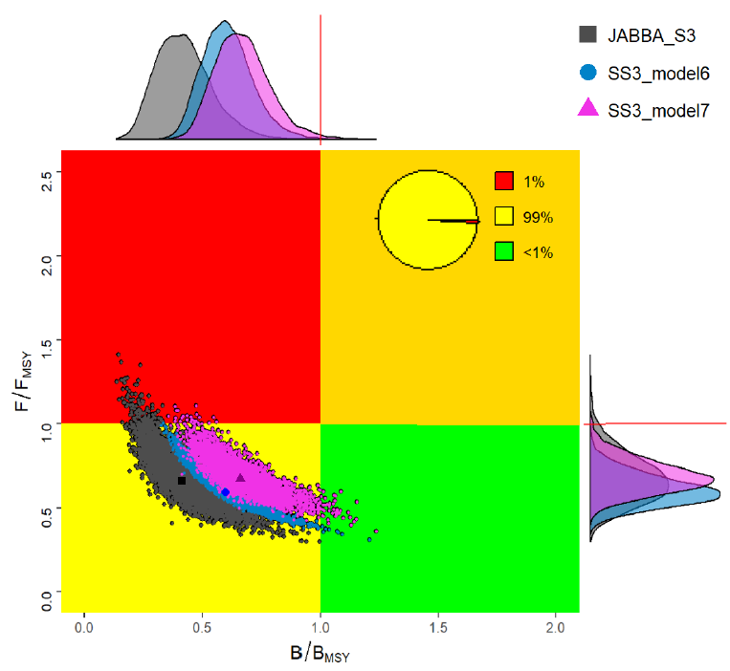
WHM State of the Stocks
White marlin status
Last assessment in 2019 (estimates of stock status for 2017)
Results showed that the stock was overfished but not undergoing overfishing.
stock status (last data: 2017)

Slide 8
SAI Fishery Indicators
Sailfish annual catch by gear
EAST
East Stock
Catch (2018: 935 t; 2019: 2,015 t; 2020: 1182 t)
TAC (2017-2020): 1,271 t
WEST
West stock:
Catch (2018: 1519 t; 2019: 1,361 t; 2020; 1152 t)
TAC (2017-2020): 1,030 t

Slide 9
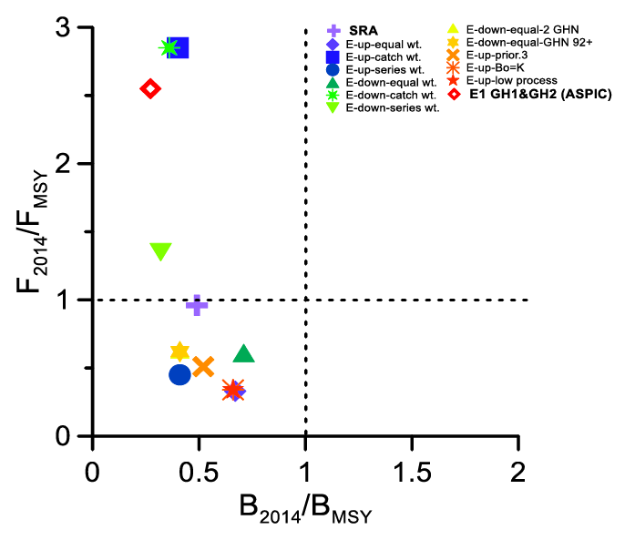
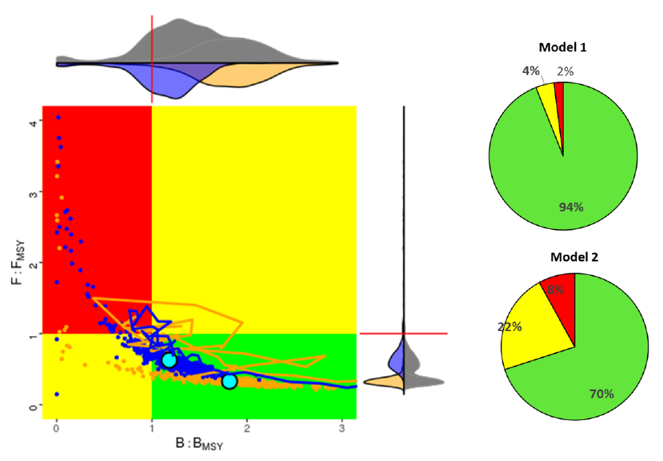
SAI State of the Stocks
Sailfish stock status
EAST
WEST
Stock status in 2014
Last assessment in 2016 (estimates of stock status for 2014)
EAST: all scenarios considered the stock is overfished, but overfishing status is uncertain
WEST: both models indicated that the stock is neither overfished nor experiencing overfishing
Notes:
Models used:
EAST - Combined Kobe plot from a set production models and Stock Reduction Analysis
WEST - Combined Kobe plot two integrated SS3 models
Last assessment 2016 with estimates of stock status for 2014.
For the East all the scenarios considered for advice using the surplus production models indicated that the stock is overfished (0.27-0.71 BMSY), but overfishing status is uncertain (0.33-2.85 FMSY)
For the West both Stock Synthesis models indicated that the stock is neither overfished nor experiencing overfishing

Slide 10
SAI Effect of current regulations
ICCAT [Rec. 16-11] establishes that if the total catch harvested any year exceeds 67% of the estimated MSY (1,271 t in the EAST and 1,030 t in the WEST),the Commission shall review the recommendation and effectiveness of this.
  EAST Atl.: Catches exceeded total catch level in 2017 and 2019, but not in 2018 and 2020.
  WEST Atl.: Catches exceeded total catch level in 2017, 2018, 2019 and 2020.

Slide 11
BIL Responses to the Commission
21.14 Revise the statistical methodology used to estimate dead and live discards and provide feedback
to CPCs, Rec. 19-05, para 16
Only two CPCs have provided papers and information on the methods for estimating discards from ICCAT fisheries of bycatch species such as billfish (…). The Committee was supportive of the work done and further work is ongoing on some of the issues identified.
(…) The Committee reminds CPCs which have not yet presented documentation on the bycatch estimation methodologies used and of their obligation to do so. Until the Committee can review the methodologies currently used by other CPCs, the Committee is not in a position to provide suggestions for any necessary improvements.
With regards to artisanal fisheries, the Committee was informed that there are no discards as all billfish specimens are retained and landed. As such in those cases the landings represent the total catch.

Slide 12
BIL Responses to the Commission
21.15 Develop recommendations for Electronic Monitoring Systems, Rec. 19-05, para 20
A Subgroup within the Billfishes Species Group was created to start addressing this issue.
Noted that there are already minimum standards recommended by the Committee for Electronic Monitoring Systems (EMS) on purse seine fisheries (Ruiz et al., 2017).
The Subgroup worked intersessionally during 2021, and at present the Committee does not yet have a final recommendation to provide to the Commission on the use of EMS for pelagic longline fisheries.
The Subgroup will continue to work on this issue in later 2021 and during 2022, aiming to provide a more consolidated answer in 2022.
The expanded Subgroup will also be available to review the scientific component of any standards provided intersessionally by IMM.

Slide 13
BIL Responses to the Commission
21.16 Explore potential technical changes to the terminal gear and fishing practices that could reduce
bycatch and bycatch mortality (at-vessel and post-release). Design and implement a study(ies) to
compare the effects of hook shape and size on catch rates. Rec. 19-05, para 21
A Subgroup within the Billfishes SG was created to start addressing the issue related with experimental studies for longline technological gear changes.
The Committee recognizes that a large number of scientific studies on the effects of terminal gear (e.g. hook size and type) and fishing practices on catch rates and survival of several bycatch and target species are already available. The Committee will allocate effort reviewing and summarizing these studies. This review will inform the Committee in its further work on these issues.
The Subgroup worked intersessionally during 2021, and at present the Committee does not yet have a final recommendation to provide to the Commission on the planning of experimental field studies to address this issue.
The Subgroup will continue to work on this issue in later 2021 and during 2022, aiming to provide a more consolidated answer to the SCRS in 2022.

Slide 14
BIL Recommendations with financial implications
Enhanced Program for Billfish Research (EPBR) – The highest priorities for 2022 are to support the objectives established by the billfish work plan and those of the EPBR, some that have been delayed due to covid-19:
  Continue the growth study of the 3 priority billfish species in the eastern Atlantic;
  Continue reproduction study of blue marlin in the Gulf of Mexico;
  Technical workshops on age reading:
    2022: workshop to standardize ageing protocols and reading guidelines
    2023: workshop for building reference sets for spines and otoliths
Worskhop on small scale fisheries (artisanal) in West Africa, with the objective of collecting detailed information describing the fisheries and sampling programmes, aiming to improve the collection and submission of billfish data in these regions.
(Details of funding requests on Document STF-209)

Slide 15
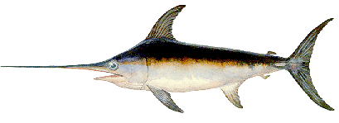
Swordfish Species Group
SWO - SWORDFISH
3 stocks
(North Atlantic, South Atlantic, Mediterranean)

Slide 16
SWO Atlantic - Fishery Indicators
North Atl
Atlantic Swordfish
North Atlantic:
Catch (2020): 10,446 t
TAC (2020): 13,200 t
South Atl
South Atlantic:
Catch (2020): 8,933 t
TAC (2020): 14,000 t

Slide 17
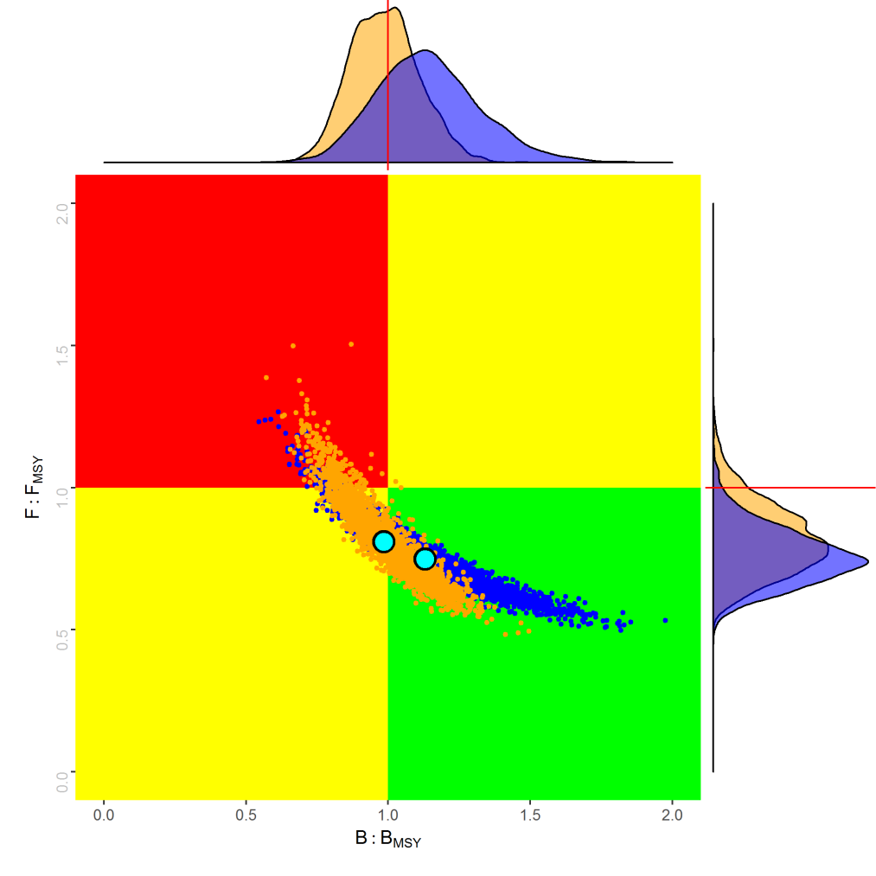
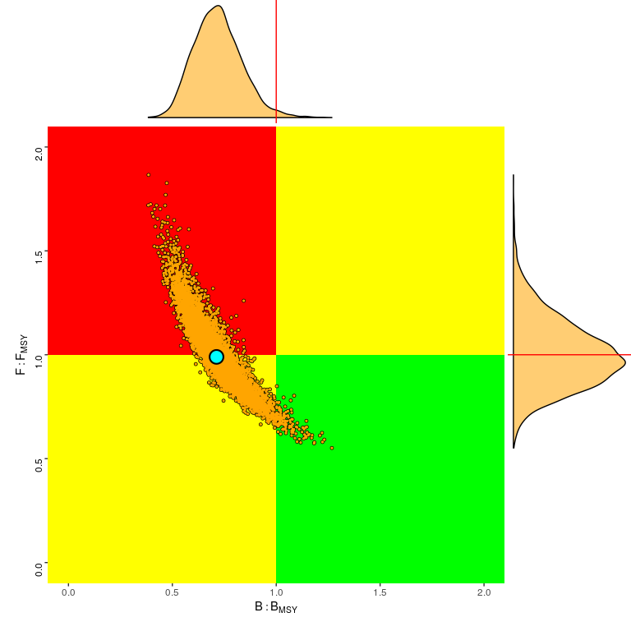
SWO State of the Stocks
Kobe plots from 2017 assessment (data until 2015)
North Atlantic
South Atlantic
5%
2%
33%
51%
47%
61%
61% probability that stock was at or above MSY reference levels
Stock biomass was overfished; overfishing was either occurring or very close to occurring.
Notes:
Last assessment in 2017, data until 2015
Models used:
North - Production Model (JABBA - orange) and Integrated analysis (SS - blue)
South - Production Model (JABBA)

Slide 18

N-SWO Atlantic - MSE
Progress on N-SWO MSE
Year | Key events
2018 | Process initiated; initial OM uncertainty grid generated
2019 | OM development; technical expert develops initial MSE framework; conceptual management objectives adopted (Res 19-14)
2020 | OM development; early cMP development
2021 | OM grid revisions (reduce grid redundancy; account for discard mortality); cMP development; candidate performance indicators; MSE code review from external expert; candidate advice intervals
2022 | Stock assessment; OM reconditioning; cMP development. Dialogue with PA4 on cMPs, operational management objectives and performance indicators
2023 | Continue MSE with feedback from PA4. Commission to review cMPs and adopt an MP at the Annual Meeting, including TAC. Exceptional circumstances protocol to be adopted following PA2/ALB protocol
2024+ | MP to be run on predetermined timescale
(Details of the MSE roadmap in PLE-113)

Slide 19
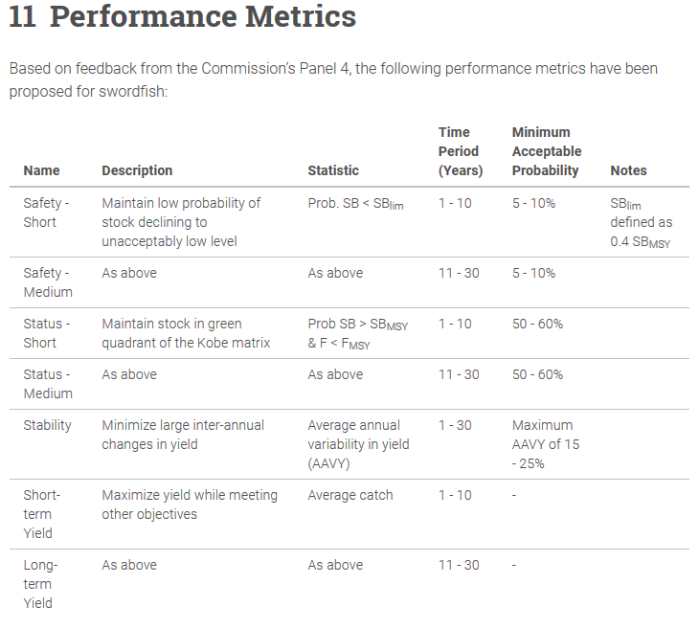
N-SWO Atlantic - MSE
Dialogue with PA4
July 2021: PA4 presented with informational update to NSWO MSE:
  Grid overview
  Considerations on performance metrics
  Candidate advice intervals
  Exceptional circumstances protocol
Request PA4 discuss and provide further guidance on:
  Performance metrics
  Advice intervals

Slide 20
SWO Mediterranean Fishery Indicators
Mediterranean Swordfish
Catch (2020): 7,604 t
TAC (2020): 9,583 t

Slide 21
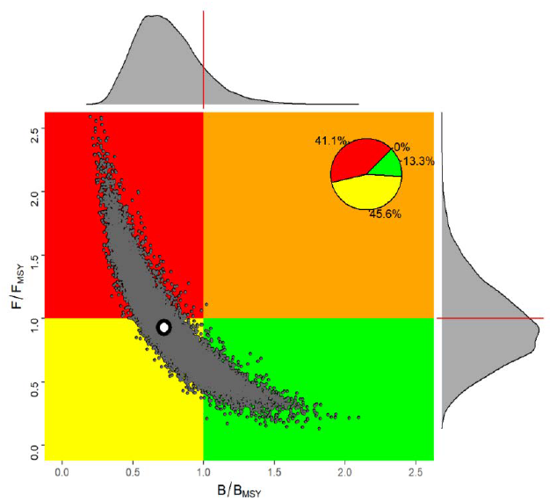
SWO Med State of the Stock
Kobe plots from the 2020 assessment
Stock status from the 2020 assessment (data until 2018).
The assessment indicated that the stock was most likely overfished and current fishing mortality just below Fmsy levels

Slide 22
SWO Responses to the Comm
21.12 SCRS advice on conservation and management measures for N-Atl swordfish, Rec. 17- 02, para 5
Background: The Commission shall establish at its 2021 meeting conservation and management measures for North Atlantic swordfish on the basis of the SCRS advice resulting from the latest stock assessment as well as the Resolution by ICCAT on Criteria for the Allocation of Fishing Possibilities [Res. 15-13]…
Since the stock assessment did not take place in 2021 as originally planned by the SCRS, the Committee is
not in a position to provide the requested response to the Commission.
21.13 Interim limit reference (LRP) of 0.4*BMSY or any more robust LRP established through further
analysis, Rec. 17-03, para 12
Background: When assessing stock status and providing management recommendations to the Commission in 2021, the SCRS shall consider the interim limit reference (LRP) of 0.4*BMSY or any more robust LRP established through further analysis.
Since the stock assessment did not take place in 2021 as originally planned by the SCRS, the Committee is
not in a position to provide the requested response to the Commission.

Slide 23
SWO Recommendations with financial implications
Applied to all stocks (Atlantic and Mediterranean)
Swordfish Year Programme (SWOYP): Biology and stock structure study . the Committee recommends as high priority to continue biological studies on swordfish (this recommendation applies to both the North and South Atlantic and Mediterranean stocks).
  Satellite tagging: continue deployment of satellite tags
  Reproduction: continue analysis gonads
  Age and growth: finish processing spines/otoliths, and start an age validation bomb-radiocarbon study
  Genetics: continue population analysis of tissue samples for stock differentiation, and a pilot study on epigenetic ageing
  Workshops: Workshop on the reference set for age and growth
Specific for the North Atlantic
  Continuing MSE for N-SWO: Work started in 2018, and the SCRS recommends funding for continuing the swordfish MSE work for 2022-2023.
(Details of funding requests on Document STF-209)

Slide 24
Sharks
SHK - SHARKS
SMA
BSH
POR
…and 21 more species (sharks and rays)
Notes:
Blue shark, shortfin mako and porbeagle are large pelagic sharks that the SCRS has assessed those with more traditional fishery assessment models.
The SCRS has conducted an Ecological Risk Assessment for these and another 13 Atlantic shark species ( a total of 20 stocks).
New ICCAT convention amendment has a list of 24 species (sharks and rays) that are oceanic, pelagic and highly migratory.
But the 3 main ones (BSH, SMA and POR) constitute the majority of the catches in ICCAT

Slide 25
Sharks Fishery Indicators
Blue shark catch statistics
BSH - North
Catch (2018-20): 33,995 t; 27,207 t; 20,827 t
TAC (2018-20): 39,102 t
BSH – South
Catch (2018-20): 34,383 t; 34,734 t; 33,652 t
TAC (2020): 28,923 t

Slide 26
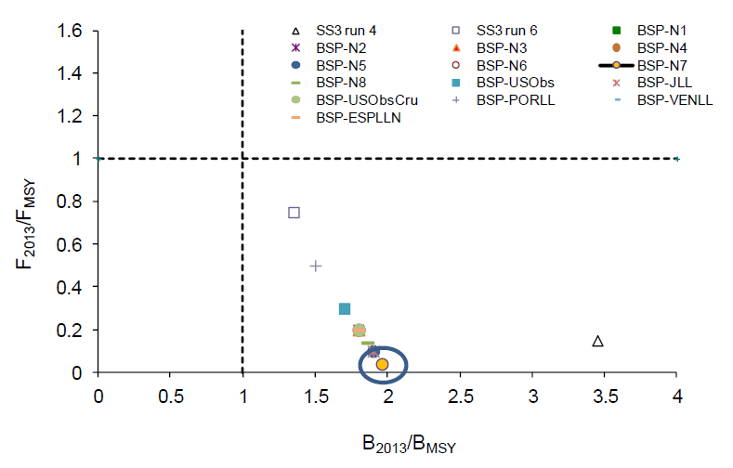
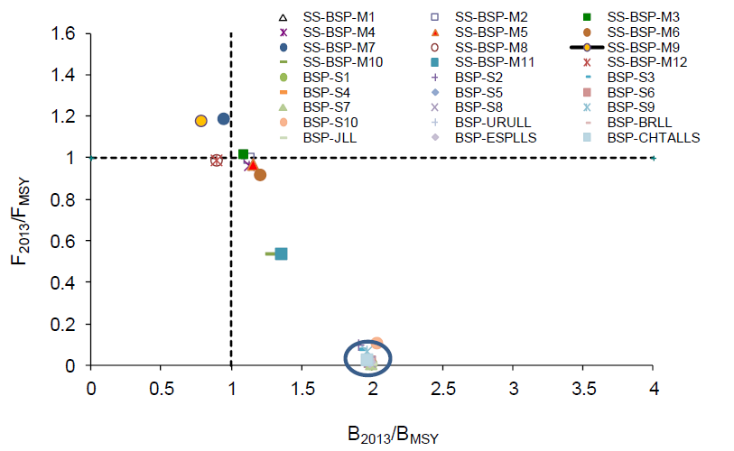
BSH Stock Status
Blue shark stock status (assessed in 2015, data until 2013)
North Atlantic
North: All scenarios indicated that the stock was not overfished and that overfishing was not occurring
South Atlantic
South: The stock could be overfished and overfishing could be occurring
Notes:
Results from production models (BSP) and SS3 models
The circles in the plots denotes common status for several BSP runs

Slide 27
Sharks Fishery Indicators
Shortfin mako catch statistics
SMA - North
Catch (2018-20): 2373 t, 1882 t, 1709 t
SMA – South
Catch (2018-20): 3158 t, 2308 t, 2855 t

Slide 28
SMA Stock Status
SMA 2017 stock status (data until 2015)
South Atlantic
North Atlantic
28%
10%
38%
90%
34%
F/Fmsy
F/Fmsy
B/Bmsy
B/Bmsy
Stock abundance was below Bmsy and fishing mortality above Fmsy (90% probability).
Combined probability of the stock being overfished was 32.5% and that of experiencing overfishing was 41.9%
Notes:
In 2019, projections for the North Atlantic were carried out with Stock Synthesis only. The Committee noted that because the fishery mainly focuses on juvenile animals, the production models (BSP2JAGS and others) are only tracking juvenile abundance and thus the projections are not informative about trends in the mature population, which would lag behind the trends in the exploitable population by the number of years it takes new recruits to reach maturity.

Slide 29
POR Atlantic - Fishery Indicators
Porbeagle shark catches
Catch (2020)
  NE Atl: 3 t
  NW Atl: 11 t
  SE Atl: 0 t
  SW Atl: 0 t
General notes on shark statistics:
Global statistics on shark have improved;
… but are still insufficient to provide quantitative advice on stock status for most stocks (except BSH, SMA and POR).

Slide 30
POR Stock Status
Porbeagle 2020 stock status (data until 2018)
NW Atlantic porbeagle stock (conducted in 2020)
  The stock was predicted to be overfished in 2018 with > 70% prob., even though abundance has been increasing since 2001.
  If removals remain similar to 2014-2018 (mean = 47 mt), the stock is predicted to rebuild with at least a 50% probability between 2030 and 2035
  NE Atlantic was not carried out in 2020 (possibility of a joint ICCAT/ICES assessment)
  Due to lack of reporting, the magnitude of dead discards remains uncertain and post-release mortalities are not incorporated in this assessment, so there remains considerable uncertainty in the assessment of status.

Slide 31
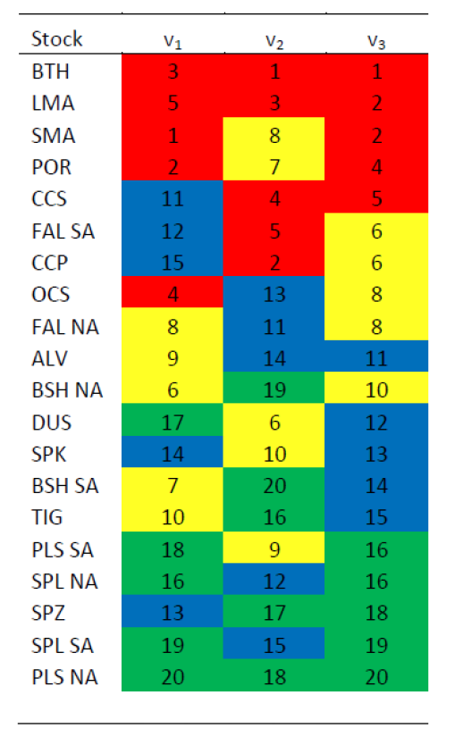
Other sharks Stock Status
Ecological Risk Assessment (last update in 2012)
Vulnerability rank for 20 stocks of pelagic sharks and rays: A lower rank indicates higher risk. Stocks listed in decreasing risk order according to the sum of the three indices. Red highlight indicates risks scores 1-5; yellow, 6-10; blue, 11-15; and green, 16-20.
Main results:
Most vulnerable stocks: bigeye thresher, longfin and shortfin makos and porbeagle (Lamniformes sharks).
Lowest vulnerabilities: scalloped hammerheads, smooth hammerhead and pelagic stingray

Slide 32
Responses to the Commission
Shortfin mako
21.17 The SCRS should provide advice. Rec. 19-06, para 11
The SCRS reviewed several research papers that were potentially relevant for the management of SMA. However, the Committee is unable to draw conclusions or provide additional advice at this time based on this research.
The Committee has no additional advice to that provided in 2019.

Slide 33
Responses to the Commission
North Atlantic blue shark
21.18 Updated TAC advice in 2021, or at an earlier stage if enough information is provided. Rec. 19-07, para 2)
21.19 Provide, if possible, options of HCR with the associated limit, target and threshold reference points for the management of this species in the ICCAT Convention area. Rec. 19-07, para 8
Since the stock assessment did not take place in 2021 as originally planned by the SCRS, the Committee is not in a position to provide the requested response to the Commission.

Slide 34
Responses to the Commission
South Atlantic Blue shark
21.20 Update TAC advice in 2021. Rec. 19-08, para 2
21.21 Provide, if possible, options of HCR with the associated limit, target and threshold reference points for the management of blue shark in the ICCAT Convention area. Rec. 19-08, para 8
Since the stock assessment did not take place in 2021 as originally planned by the SCRS, the Committee is not in a position to provide the requested response to the Commission.
The Committee noted that the 2020 catches (of 33, 652 t) exceeded by about 16% the Total Allowable Catch (TAC, of 28,923 t) for South Atlantic blue shark outlined in Rec. 19-08 (para. 2).

Slide 35
SHK Recommendations with financial implications
Provide funding for continuing the Shark Research and Data Collection Programme SRDCP:
  Complete work on South Atlantic shortfin mako age and growth;
  Continue shortfin mako stock differentiation, and start stock differentiation for blue shark and porbeagle;
  Continue work on movement and habitat characterization of silky, oceanic whitetip, longfin mako and hammerhead sharks through satellite tagging.
(Details of funding requests on Document STF-209)

Slide 36
SMT - Small Tunas
SMT – SMALL TUNAS
BLF
SSM
LTA
BON
BLT
FRI
…and 7 more species
Notes:
They range in maximum size from more than 2 meters (wahoo) to just over half a meter (frigate tuna)

Slide 37
Small Tunas Fishery Indicators
Small tunas catches
Small tunas can reach high levels of catches and values in some years;
High relevance from a social and economic point of view;
Important for many coastal communities and a main source of food;
Likely underestimation of total landings, due to the difficulties in data collection.
Notes:
The 13 species of small tuna can reach high levels of catches and values in some years
Those species can have a very high relevance from a social and economic point of view, because they are important for many coastal communities in all areas and a main source of food.
Their social and economic value is often not evident because of the underestimation of the total landing figures, due to the difficulties in data collection…

Slide 38
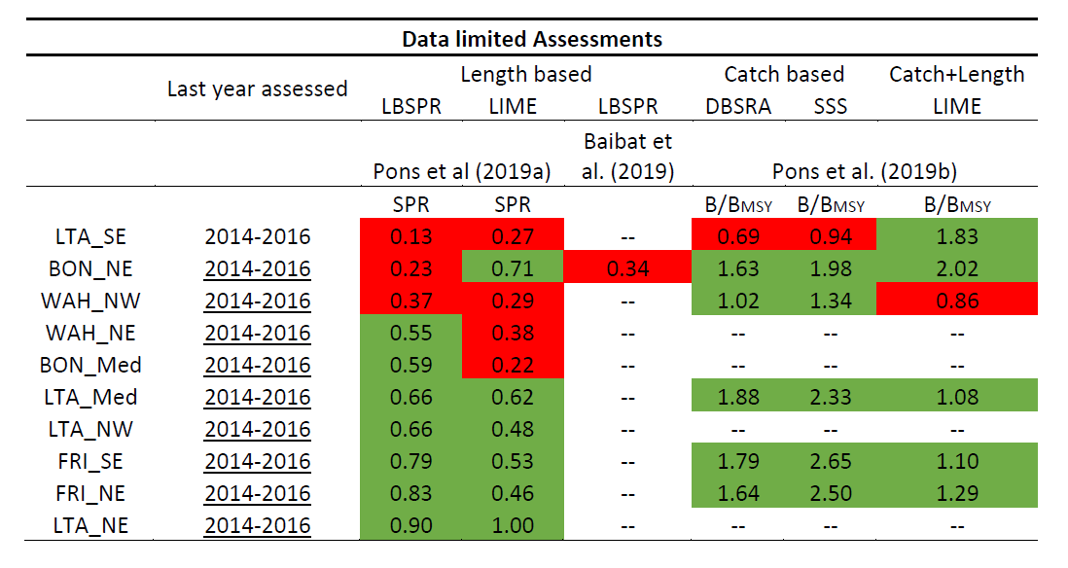
SMT State of the Stocks
Status estimated in 2019 using data-limited approaches
State of some stocks determined with a series of data-limited approaches.
In 2019 this was applied to 10 stocks: LTA_SE and WAH_NW show some signs of overfishing, deserving special attention in the future.
Notes:
How are the Small tunas being assessed (data limited approaches):
- 2016-2017: Productivity/Susceptibility analysis - Defined species with high vulnerability
- 2018: First attempts for length-based Data-Limit models; evaluation of data-limited approaches
- 2019: Pons et al (2019):
- Applied Length Based Spawning Potential Ratio – LBSPR
- Length-based Integrated Mixed Effects – LIME
Note that catch data is highly unreliable, so at this point more trust is put in the length-based models

Slide 39
SMT Recommendations with financial implications
Continuing support to the SMTYP: Continuing with the ICCAT SMTYP research programme activities in 2022-2024 to further improve the biological information (improving geographical coverage for growth, maturity and stock identification) for Acanthocybium solandri (WAH) and beginning new sampling studies for Auxis thazard (FRI) and A. rochei (BLT).
Regional workshop on the application of data-limited methods: Recommend an in-person workshop be held to advance with the data limited models applied to some small tuna species.
New chapter for ICCAT Manual: The Committee recommends that a new chapter of the ICCAT Manual be added, on the narrow-barred Spanish mackerel (Scomberomorus commerson).
(Details of funding requests on Document STF-209)

Slide 40
Thank You

